Slide 1


Titolo presentazione sottotitolo
Basic Algorithm’s Block Diagram
DESIGN BY NATURE
AUTONOMOUS FREE-FLYER ASSISTED BY INTELLIGENT DAMAGE LOCALIZATION SYSTEM
Milano, XX mese 20XX

Slide 2
IMPACT
DETECTION:
The neural system
Smart Skin
Smart View
UNDOCKING & MOTION
Minimum Potential Method
DAMAGE MAPPING: Hot Spots Recognition
Machine Learing
DOCKING & LOCK
Data download,
Energy Recoverage
TURN-OFF
2

Slide 3
IMPACT
DETECTION:
The neural system
Smart Skin
Smart View
N
Is circuit online?
Y
Free-Flyer
Switched on
On-board storage of collected data
2

Slide 4
IMPACT
DETECTION:
The neural system
Smart Skin
Smart View
N
Online mapping ==GDS mapping
Y
Free-Flyer
Switched on
On-board storage of collected data

Slide 5
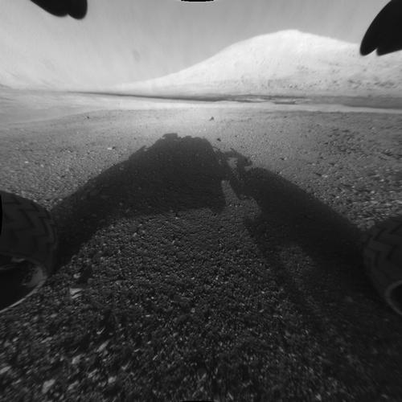
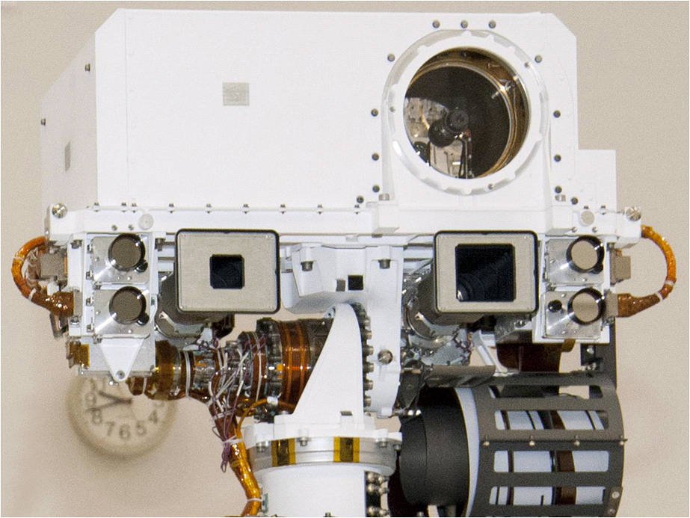
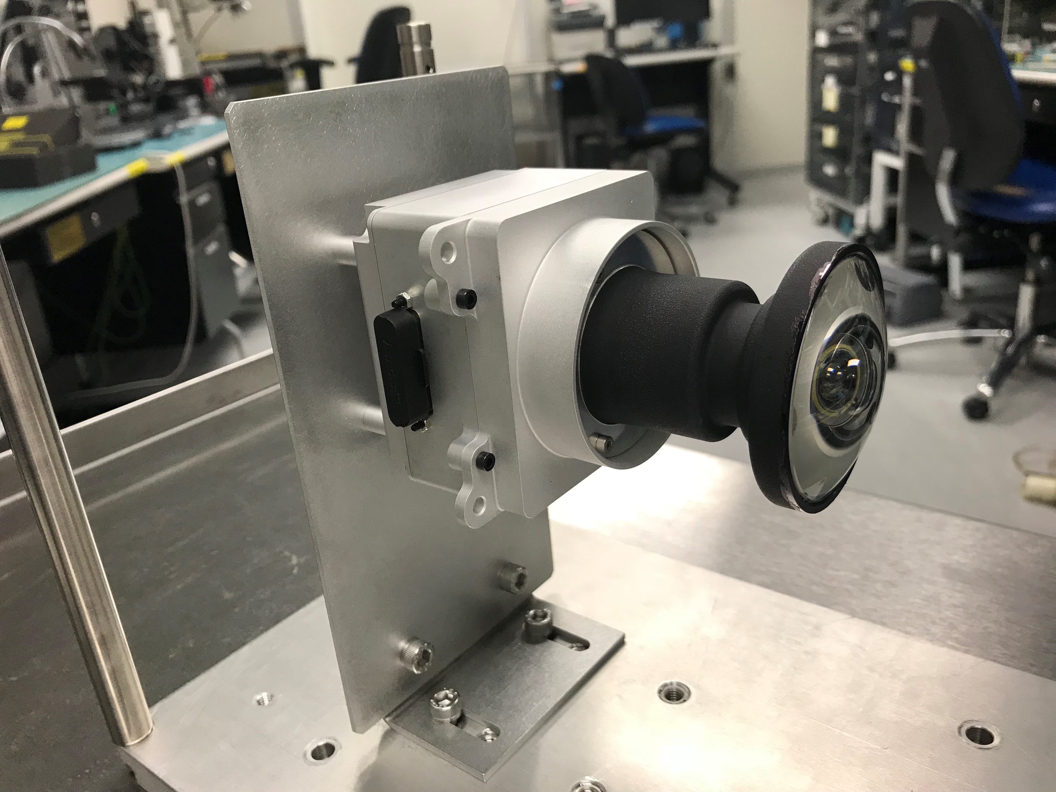
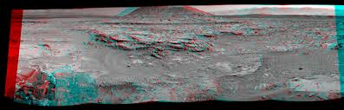
Credits: NASA
NavCam
Forward-facing monocular RGB imager
with 130° field of view (FOV), fixed focus, and 1.2
Figure 2: Exploded view with nozzle geometry
megapixel (MP) resolution.
CPU:
Dual Inforce 6501 Micro SOMs.
HazCam
Aft-facing CamBoard Pico Flexx time-of-flight flash
LIDAR depth sensor with 62° FOV, 224 x 172
resolution, and effective range 0.1-4 m.
https://mars.jpl.nasa.gov/msl/mission/rover/eyesandother/
https://mars.nasa.gov/resources/hazcam-prototype/

Slide 6
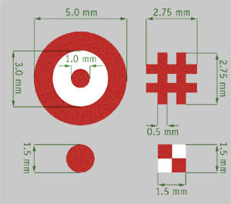
IMPACT
DETECTION:
The neural system
Smart Skin
Smart View
UNDOCKING & MOTION
Minimum Potential Method
Attitude control
with respect to the surface (NavCam +SpeedCam + fiducials)
Sector is detected
Laser Grid System Positioning (Straight lines deflection)
https://www.eurocircuits.com/fiducial/
https://www.youtube.com/watch?v=eWwp19ymChY

Slide 7
IMPACT
DETECTION:
The neural system
Smart Skin
Smart View
UNDOCKING & MOTION
Potential Field Method
DAMAGE MAPPING: Hot Spots Recognition
Pics Acquisition (NavCam)
130° FOV
Learn and Memorize
Depth Detection

Slide 8
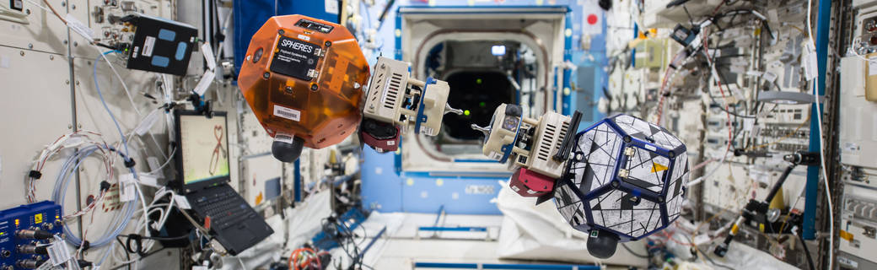
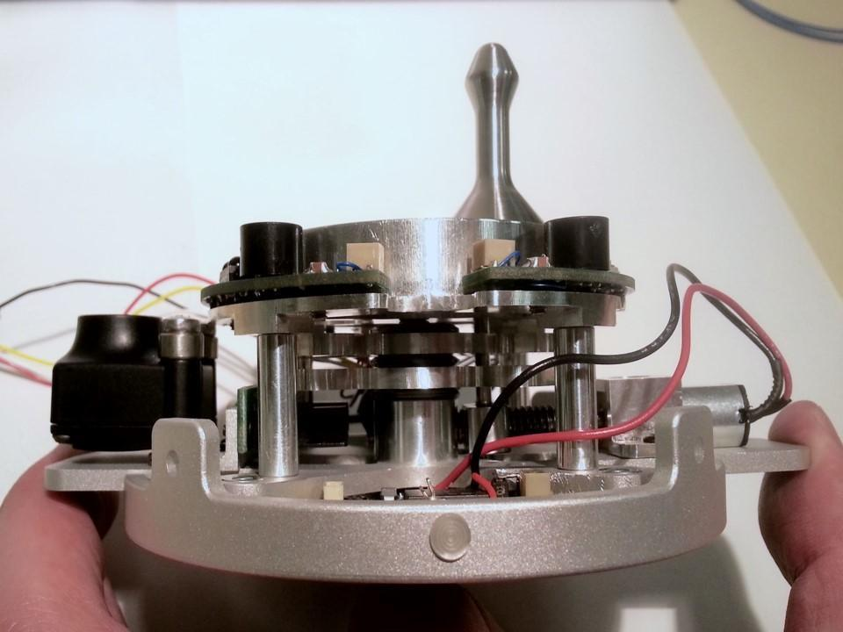
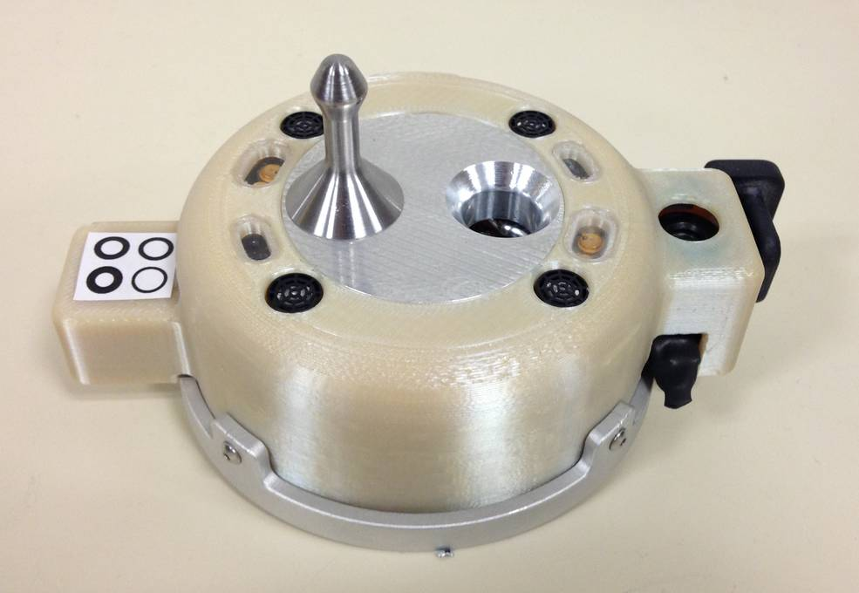
IMPACT
DETECTION:
The neural system
Credits: NASA
Smart Skin
Smart View
UNDOCKING & MOTION
Minimum Potential Method
DAMAGE MAPPING: Hot Spots Recognition
An early Docking Port prototype showing the internal cams locking mechanism (center) driven by a micro gearmotor (right) and the onboard camera to control docking maneuvers (left). (Image courtesy of MIT)
Hole Classification:
Machine Learning
DOCKING & LOCK
Data download,
Energy Recoverage
TURN-OFF
SPHERES Universal Docking Port.
Credits: MIT
https://www.youtube.com/watch?v=ZC37OzfIkjo

Slide 9
UNDOCKING & MOTION
Minimum Potential Method
DAMAGE MAPPING: Hot Spots Recognition
N
Position is inside the Motion Domain?
(Antenna Communication)
Y
NavCam + laser grid for damage detection
N
SNR > K
Y
Recall to Docking Base
HazCam pics acquisition
On-board storage of data
Level of Impact &
Level of damage
classification
DAMAGE REPORT & DATA DOWNLOAD
On-board storage of data
DOCKING & LOCK

